Slide 1
DEMO 1 & 2
Dataset 3: Physical Therapy Exercises

Slide 2
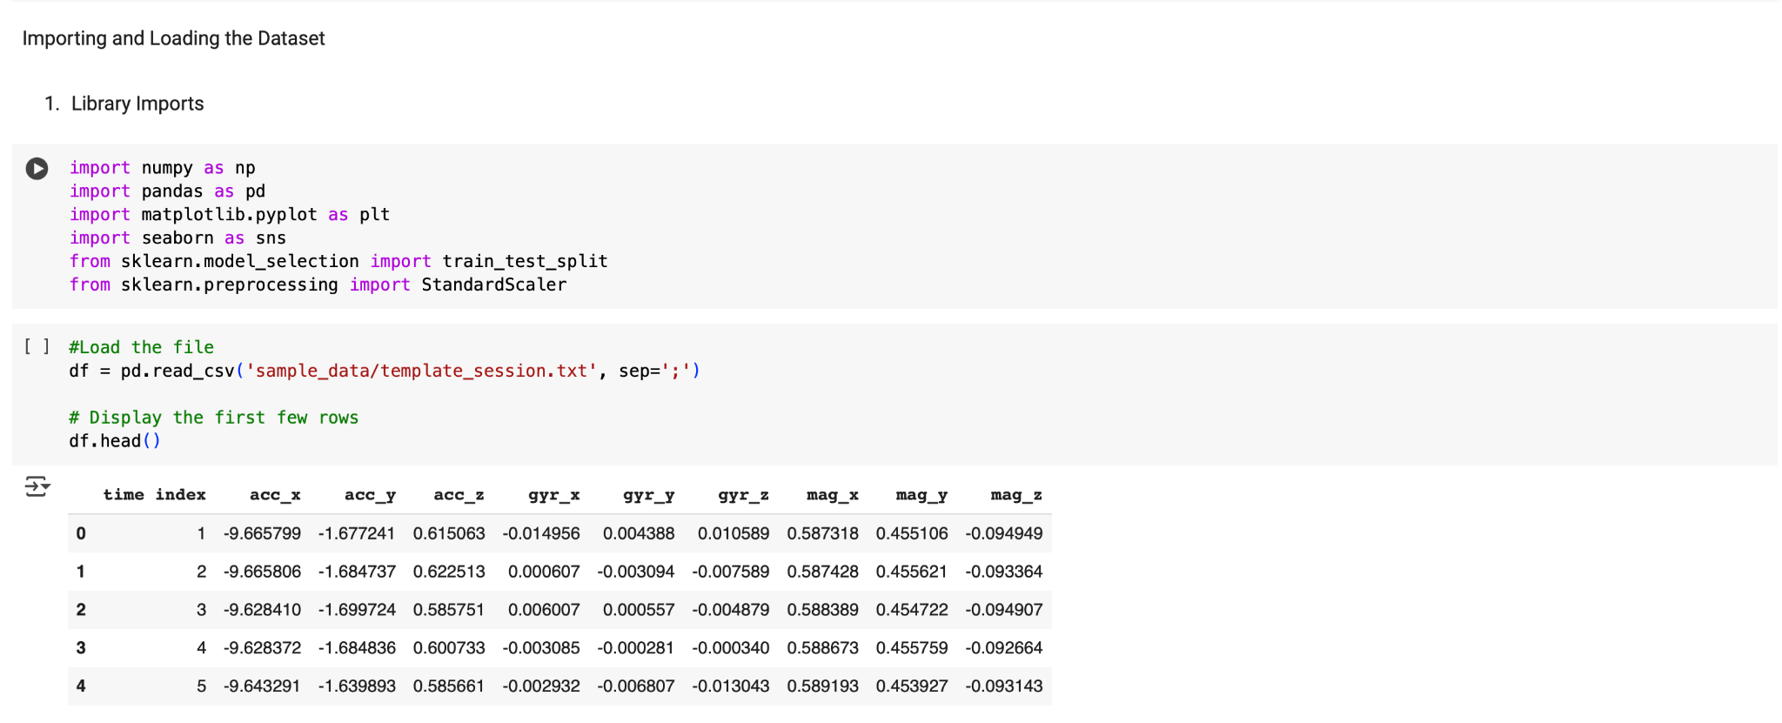
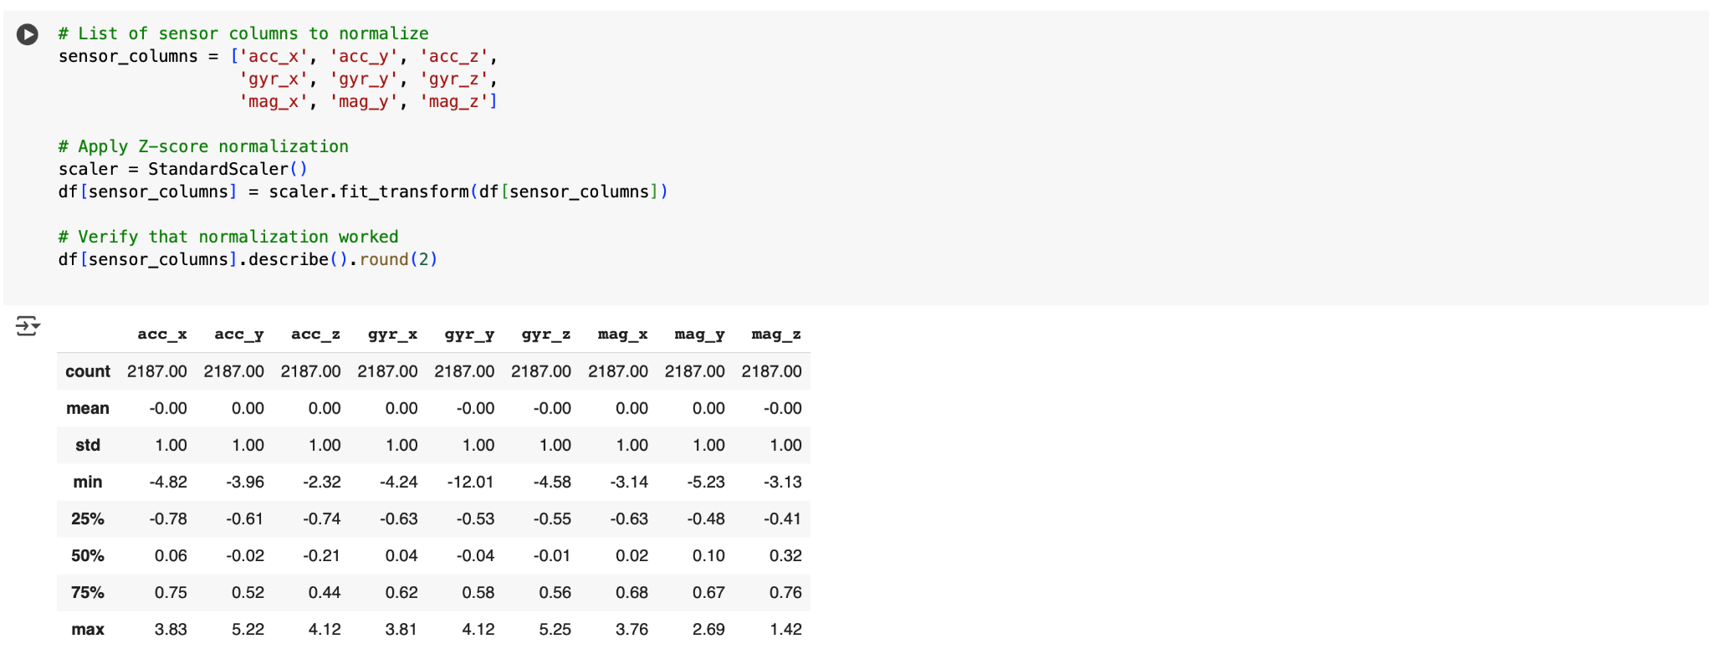
Importing and Preparing the Dataset
(Physical Therapy Exercises Dataset)
Imported Python libraries (pandas, numpy, matplotlib, seaborn, StandardScaler)
Loaded template_session.txt using Pandas
Selected sensor columns: accelerometer, gyroscope, magnetometer (X, Y, Z)
Applied Z-score normalization using StandardScaler
Why Z-score Normalization? To standardize each feature to have mean 0 and standard deviation 1. This ensures equal contribution to analysis and machine learning.

Slide 3
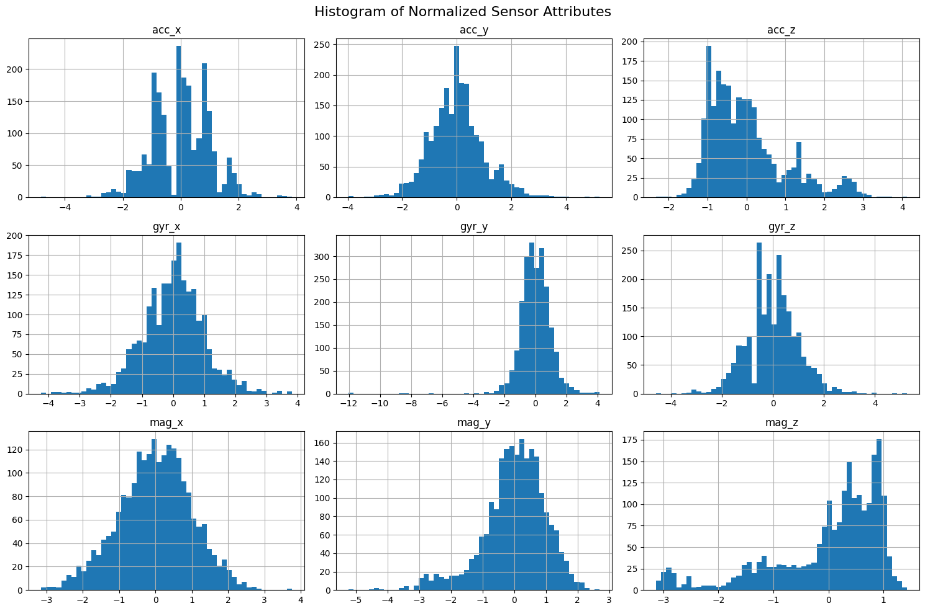
Histogram of Normalized Sensor Attributes
To explore the distribution of each sensor axis after normalization.
What the Histograms Show:
Most axes are centered around 0 (as expected after normalization)
Some are normally distributed (gyr_x, acc_y)
Some show skew or multiple peaks (acc_z, mag_y, mag_z), which may indicate distinct movement patterns or sensor noise
Useful for identifying feature behavior and potential preprocessing needs like smoothing or filtering.

Slide 4
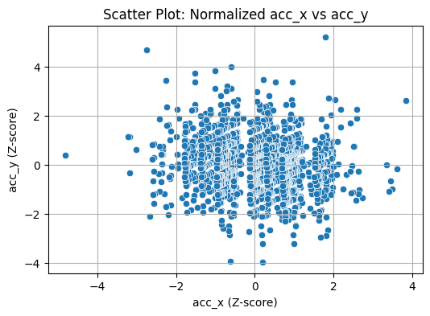
Relationship Between Accelerometer Axes (X vs Y)
To examine relationships between features after normalization.
What the Scatter Plot Shows:
acc_x and acc_y are fairly uncorrelated
Data is symmetrically scattered around (0, 0)
Indicates multi-directional motion with no strong linear trend
Scatter plots are essential for checking feature independence and useful in deciding feature combinations for modeling.

Slide 5
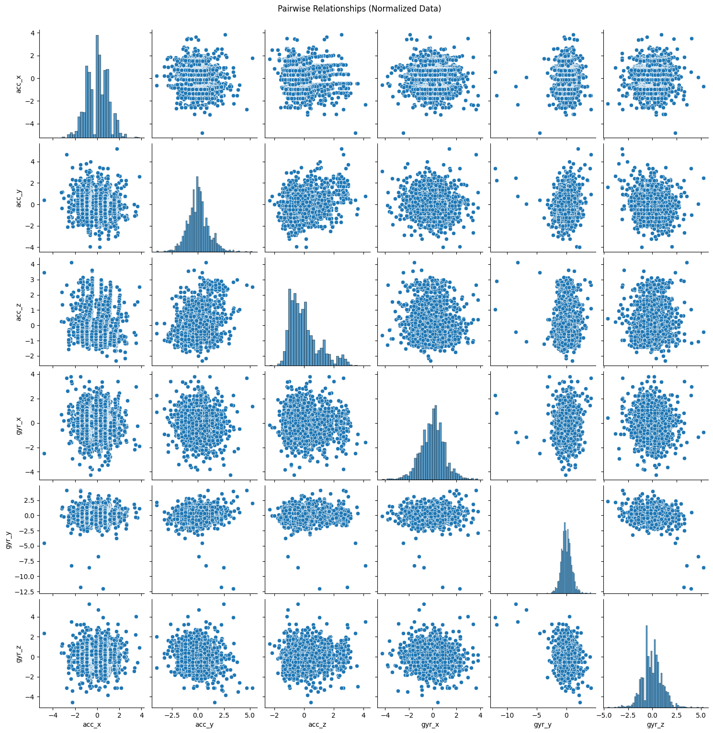
Pairwise Relationships of Normalized Data
To explore relationships and potential patterns across all accelerometer and gyroscope axes.
What the Pair plot Shows:
Diagonal: Histograms of each feature (already normalized)
Off-diagonal: Scatter plots showing relationships between feature pairs
No major multicollinearity detected, but some patterns and clustering are visible
Pair Plots are excellent for multi-feature EDA (Exploratory Data Analysis) and detecting possible redundancies or correlations.

Slide 6
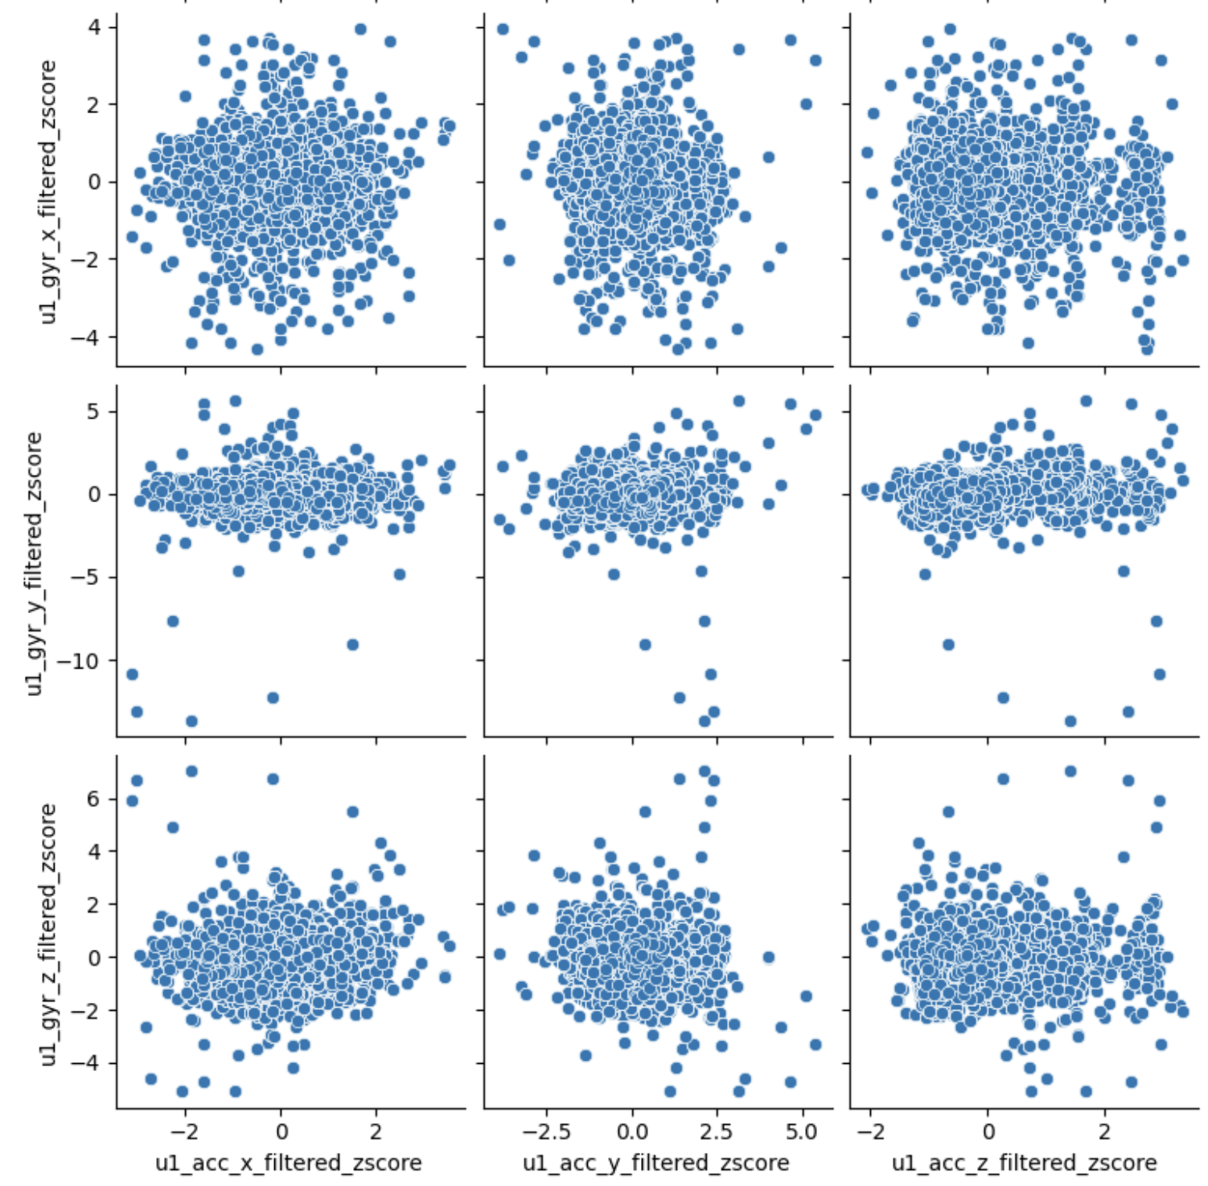
Gyroscope Vs Accelerometer
How linear acceleration correlates with rotational motion?
No strong linear trends – independent features
gyr_y has very narrow bands showing repetitive or constrained velocity in Y-axis – simple elbow or shoulder movements w/o vertical force
acc_y is the most widely spread (-2.5 - 5.0) – making it a good feature for distinguishing exercise types

Slide 7
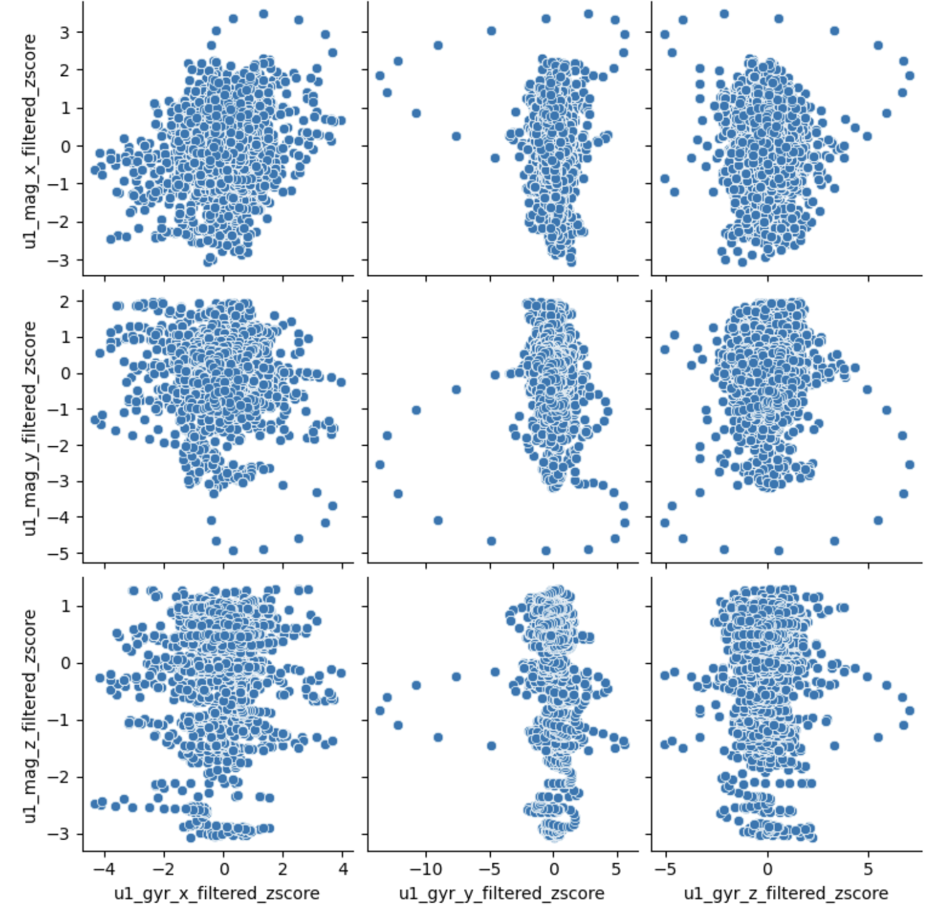
Gyroscope Vs Magnetometer
Any correlations between rotational motion and magnetic field changes?
No strong linear correlation – vertically elongated blobs
Constrained gyroscope Y readings, magnetometer values spread more — stationary/slow-rotating sensor meaning exercise was slow/controlled
Outliers indicate unusual motions — could be sensor error, high-amplitude movement, or noisee

Slide 8
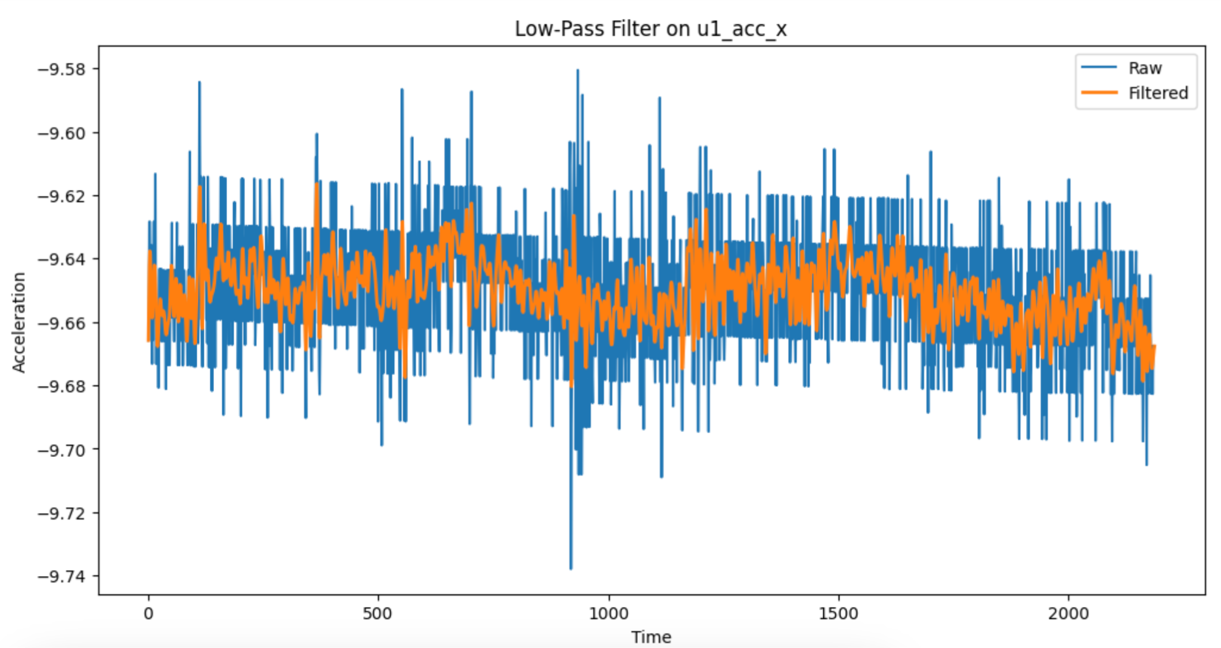
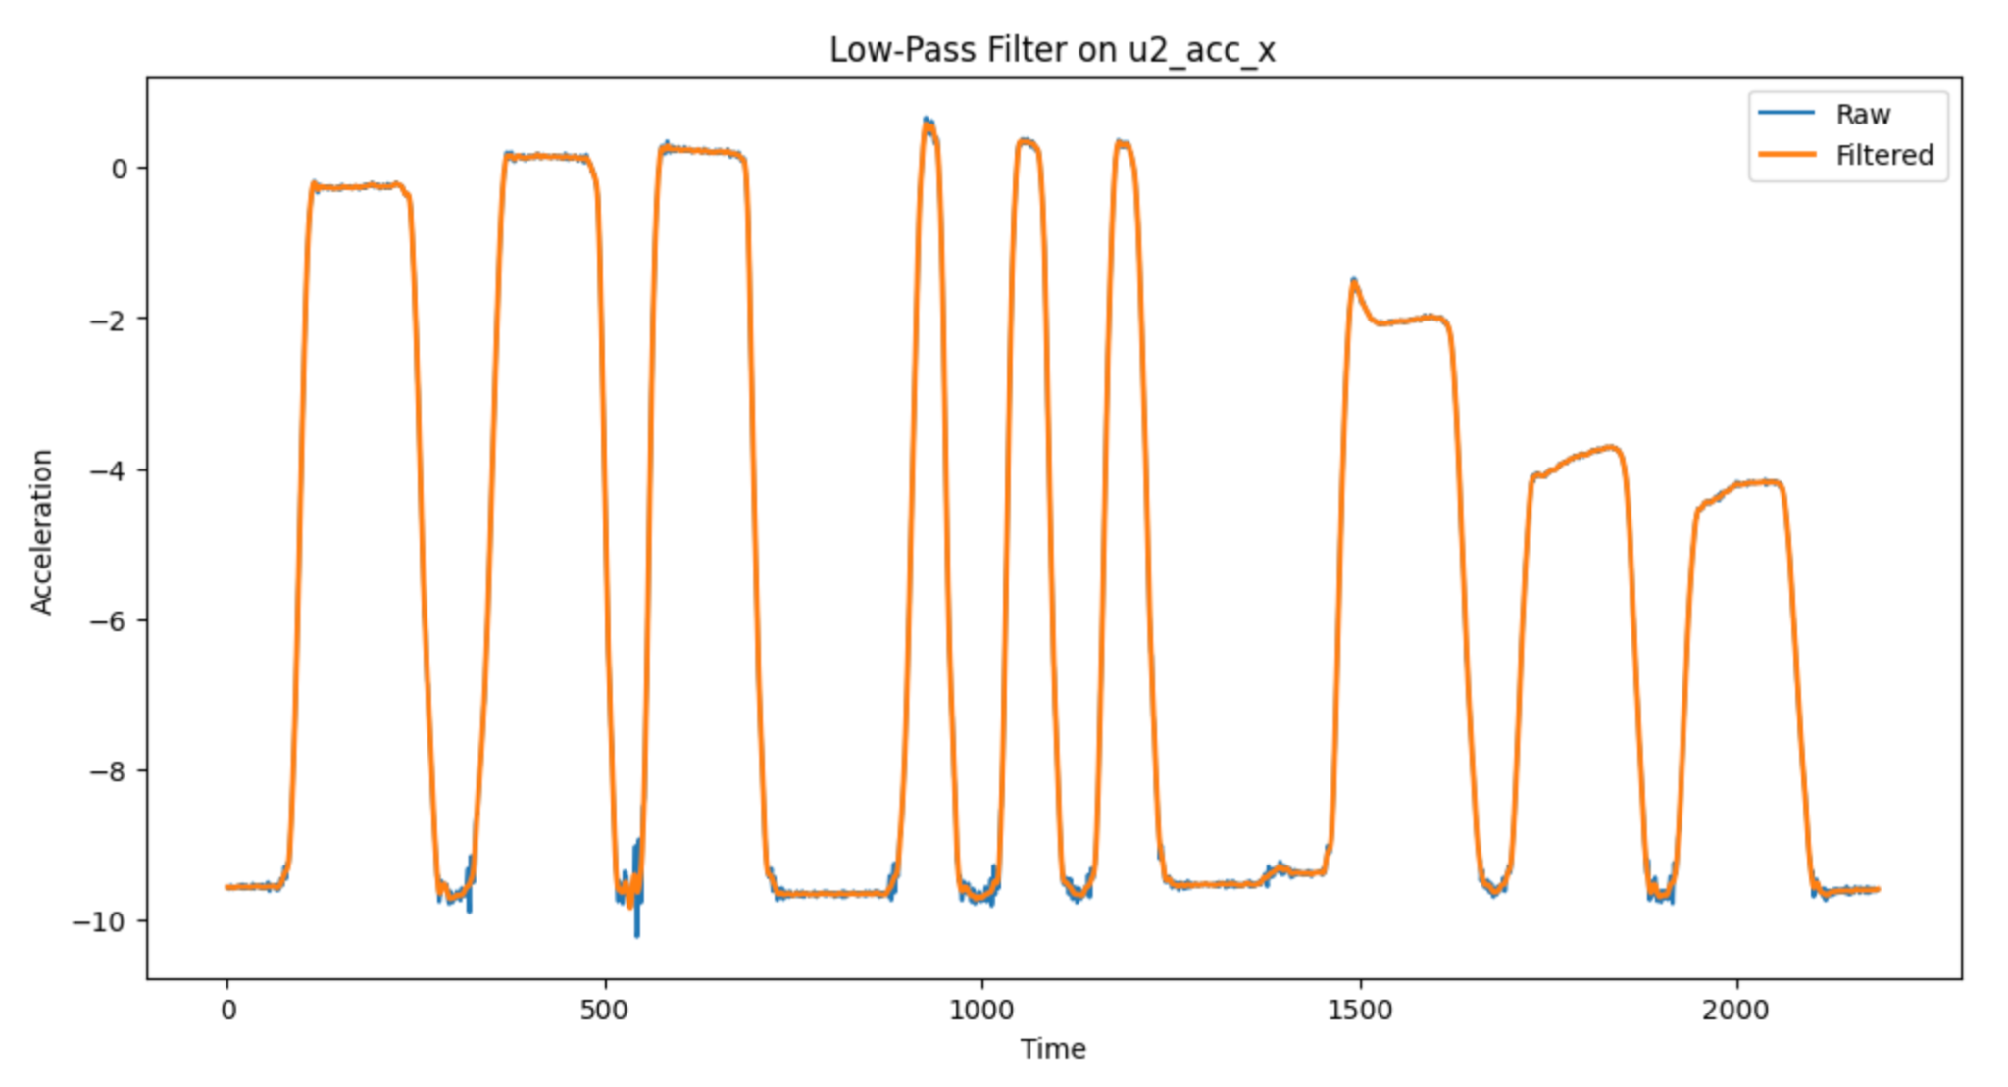
Noise Reduction (Low-pass filter) on Unit 1 & 2 acc_x
No Missing Values
Sampling frequency = 25 Hz

Slide 9
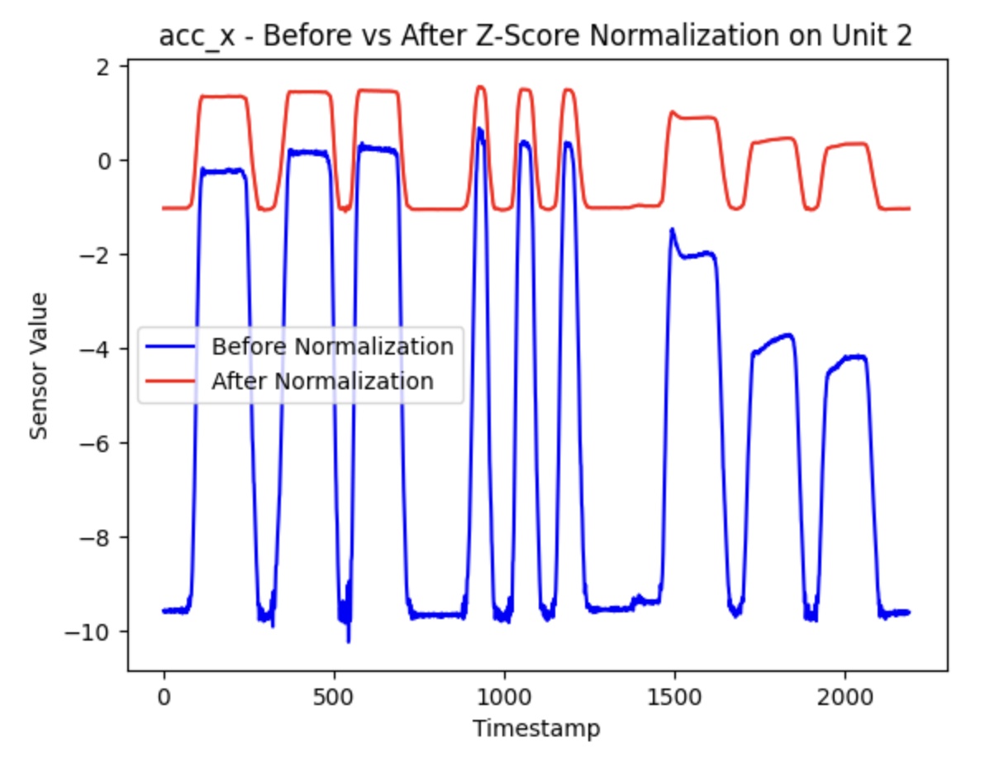
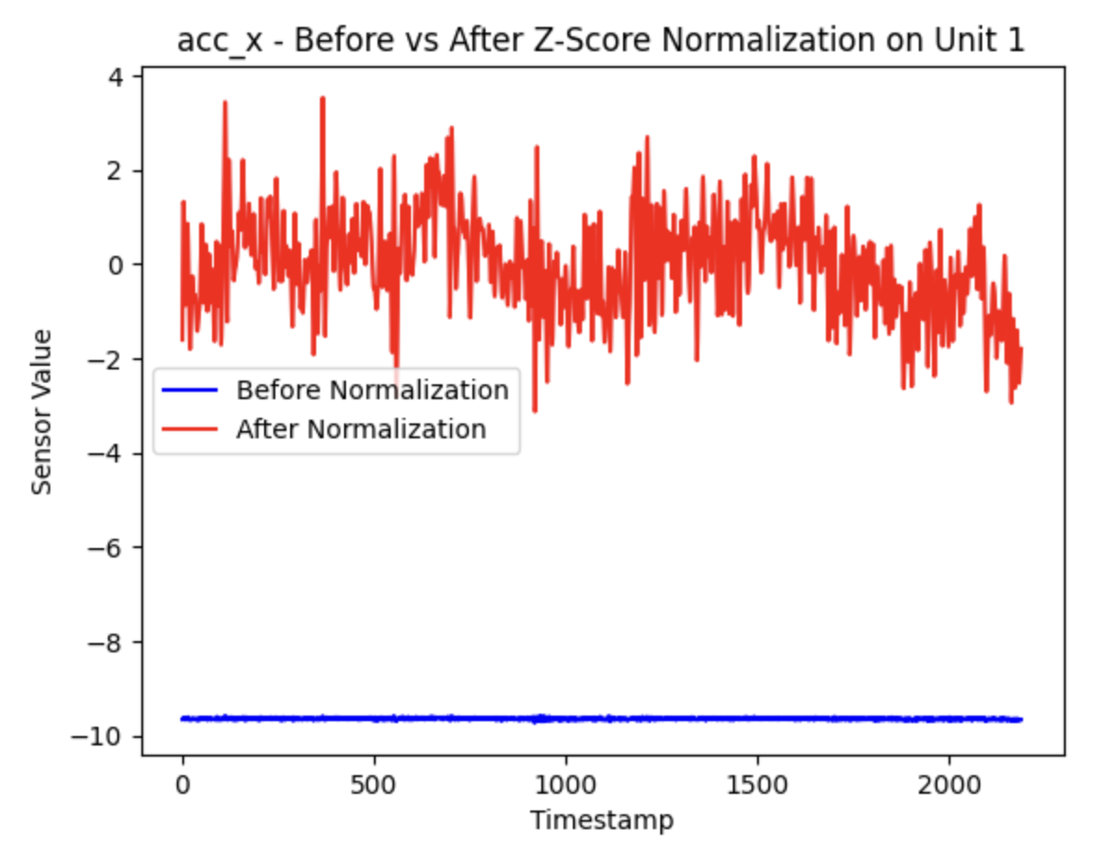
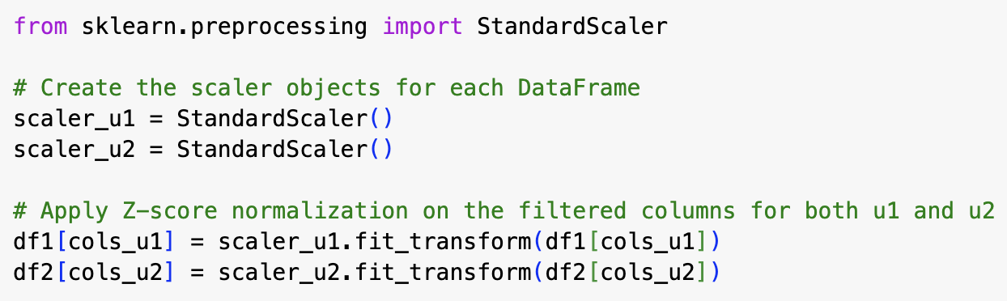
Z-Score Normalization on acc_x for Units 1 & 2

Slide 10
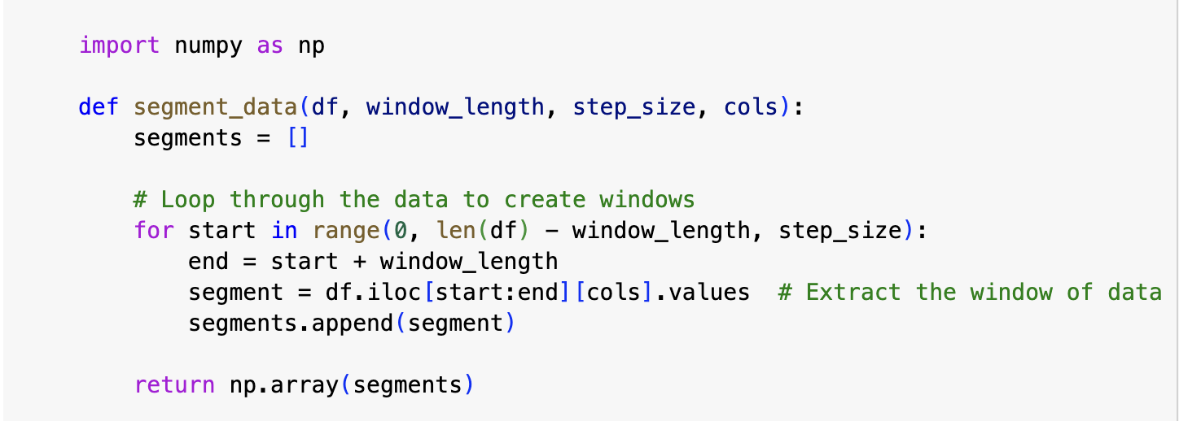
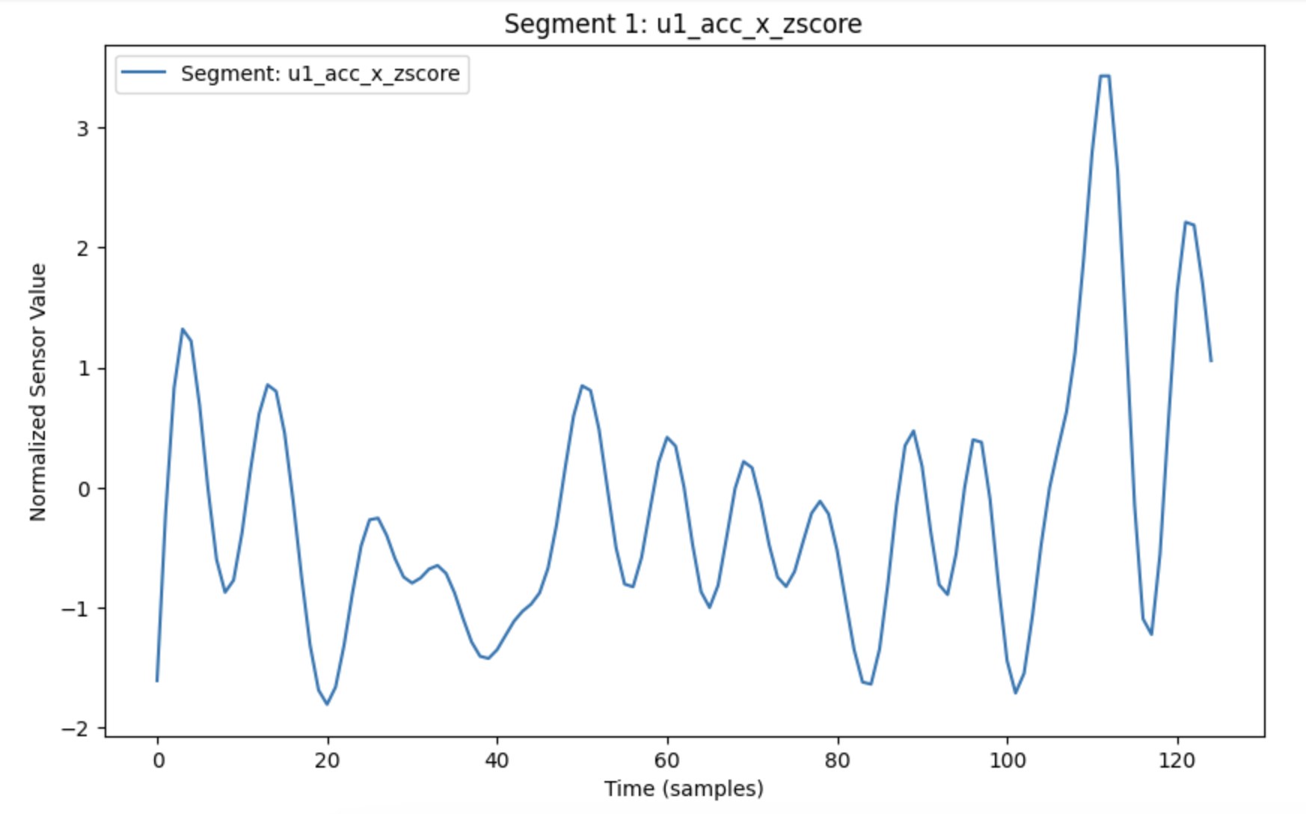
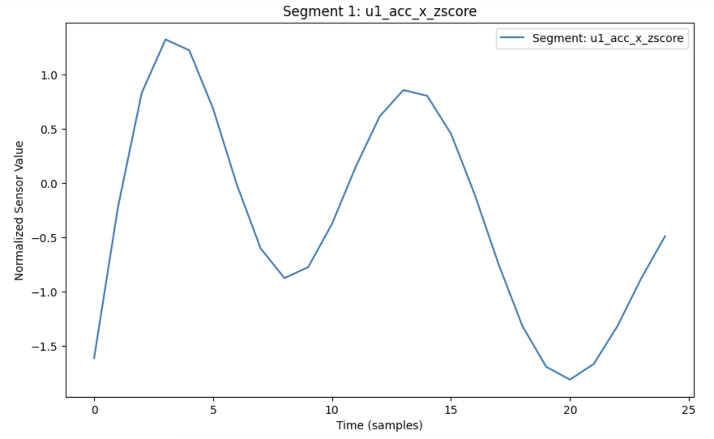
Data Segmentation
Window length: 5 sec vs 1 sec
Step size: 12 (50% overlap)

Slide 11
Thank You

